Slide 1
Git Hub
A very not formal approach to teaching…i realised after making the presentation
Git stash
GIt bisect
Git reflog
Git diff
Git switch
Git rebase
Git cherry pick
Aryan Luharuwala
21MI10015

Slide 2
Git stash
Git stash is like instagram stories create you make them and then draft them for later use and implementation.
It stores the latest changes in the form of drafts you can come up to later and gives you the first main code to add elements to.
If you are currently working on something else and want to come back to the edits you made later you can use Git stash. It transfers the code from your working directory to a stack stash and reverts the current working directory to the last commit.

Slide 3
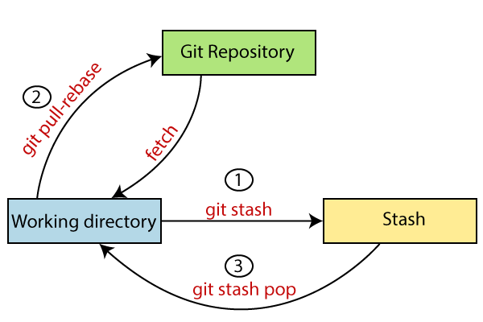
The stash acts like a temporary draft storage.
You can save incomplete files and tend to other parts of the program and come back later.

Slide 4

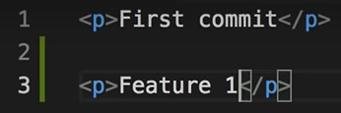



We commit this file <index.txt>. Use Git og to see the commit of your file
We add another line, but this feels incomplete and you want to work on this branch later, we use the stash command.
The latest modification are stored to the stash and the last made commit shows up
Git stash apply can be used to bring the stashed code to the master branch and display it again.
Git stash list can be used to see the status of the stashed code and the reference hash of the stash.

Slide 5

This shows the list of stash. We can select specific list numbers to apply said stash. Say git stash apply 1.
We can add comments to the stash logs using git stash push –m “<text>”.
Git stash drop is used to drop a stash of the reference number stash@{2}. The following stash indexes arrange themselves in order.
Git stash pop <refrence id> is used to apply the stash code to the master branch.
It is done when the feature addition and drafting has been done, code can be added to staging area after this.

Slide 6
Git Bisect
This command is used to track down a bug in your code, it helps find the commit or the changes you made from where the bug originated.
It is used to find the last satisfactorily working set of code from your last commits.
It uses a binary search feature to track down the faulty commit, finding the midpoint between two elements.
It uses binary search where the user gives feedback in the form of good or bad commit to narrow down the location of the bad commit.

Slide 7



// starts the binary search
//to select the starting good code hash
//to select the bad code hash
//user gives feedback of the midpoint code index
//user gives feedback of the midpoint code index
//user gives feedback of the midpoint code index
//binary search gives you the first bad commit where a bug was introduced

Slide 8
Git reflog
Reflog stands for reference log
Git keeps tracks of all the changes made to a piece of code using reference logs
Git stores the last version history and the new updated version of the code and stores the changes made as reference logs
Reflogs have timestamps attached to them.
When you make commits the order of reflogs are changed, the latest commit is showed first and the initial commit at last.
It stores all reflogs for 90 days after which its cleared.

Slide 9
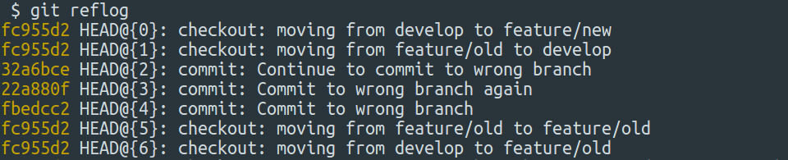
We can use commands like git reflog show –all to view all reflogs or git reflog show <branch name> to show the reflogs related to that.

Slide 10
Git diff
This command is used to see the changes between two versions of the code,
It is used to compare the codes you have committed to your remote repository from the ones in your local repository.
You can use this command to check for bugs arising due to merge, or changes you made to the next commit relative to the said commit.

Slide 11
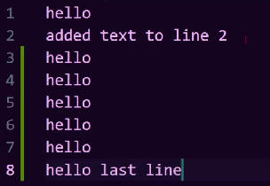



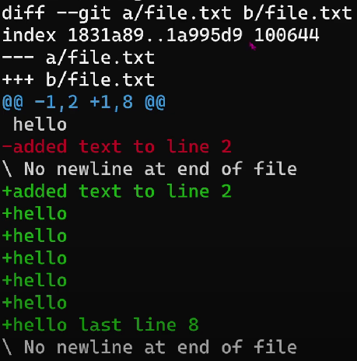
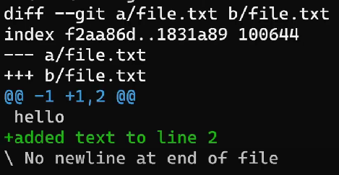

Slide 12
Git switch
You can use Git switch to switch to a new branch head.
This branch head can either already exist or Git switch can make a new branch.
Git switch is used to go to switch from the main branch to some other and revert back easily.
It makes the branch it has switched to the Head branch in the repository.
If Git cant find the name of the branch you want to switch to it can make a remote branch for you and specify links so that you can easily pull and push them on Git.

Slide 13
git switch -c <new-name>
to create a new branch
git switch -
is used to return to the last branch you switched from
git switch remote-branch
If a branch does not exist with the same name it will create a new remote branch and set up linkings so git push and pull can be operated on it
git switch other-branch –discard-changes
If the switch functions interfere with other local branches this can be used.

Slide 14
Git rebase
Git rebase is a powerful tool to combine multiple branches of the work into one.
It adds the commits in other branches in linear sequence to the commits in the master branch.
When using git rebase the commits are stored with new hash numbers and the hash from the branch is lost.
We can merge different branches with each other using rebase.
Its an alternative to merge command, It changes the history of commits.
It performs a three way merge of the 2 branches.
It deals with severe merging and should not be used on public branches.

Slide 15
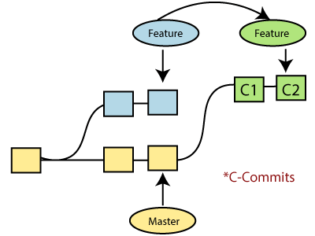
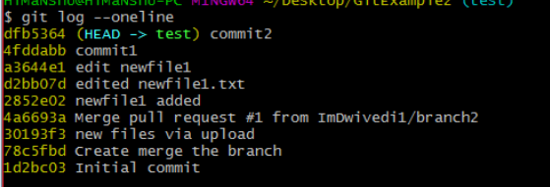

$git rebase <branch name>
$git commit -m "new commit for test2 branch."
$git add newfile.txt
$git commit -m " new commit made on the master branch."
$git checkout test2

Slide 16
Git cherry-pick
Git cherry-pick is a powerful tool to cherry pick specific commits from one branch to the main Head branch.
It is a useful tool when youve added a commit to the wrong branch.
Cherry pick can be used to pick up specific reference commits from other branches.
This makes a copy of the commit in the branch to your main branch.

Slide 17
